Slide 1
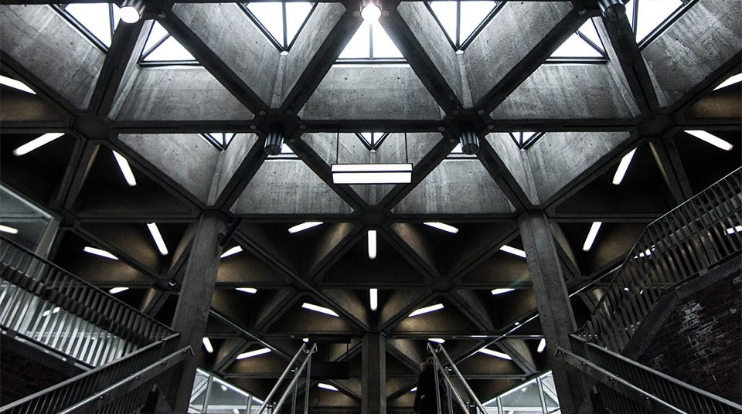
Final Exam Presentation
2
+
2
+
Aaron Gee

Slide 2
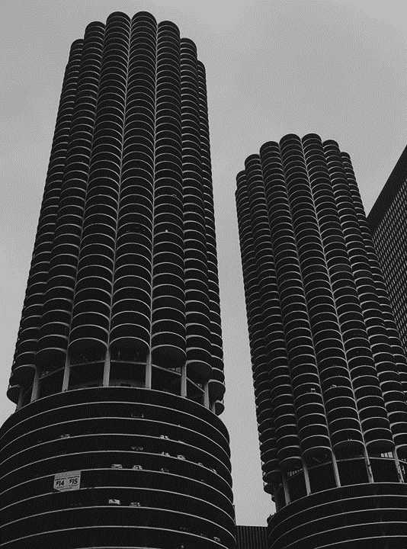
Program 1
In program 1 I will be doing the following
Taking 4 photos and make a collage
Mirror the eye in the 1st picture to center of head
Make the 2nd picture negative
Make the 3rd picture have a grid over it
Make the 4th picture blur the colors

Slide 3
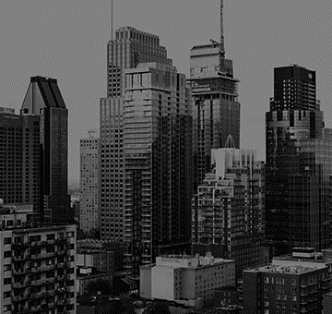
Program 1 layout
2
+
The layout for my first program includes
mainFn(path) That will have you choose the 4 pictures, make a blank canvas, and call sub function, it will also write the final canvas to the path that you choose.
subFn1 takes the 1st picture and adds it to the top left of the canvas then mirrors Kreachers eye to the middle of his head.
subFn2 takes the 2nd picture and adds it to the top right of the canvas then calls another function called negative() that will make the picture negative

Slide 4
Program 1 layout
subFn3 takes the 3rd picture and adds it to the bottom left of the canvas and then calls another function called grid() that will place a grid over the 3rd picture
subFn4 takes the 4th picture and adds it to the bottom right of the canvas and then calls another function called posterize() that blurs some of the colors in the image

Slide 5
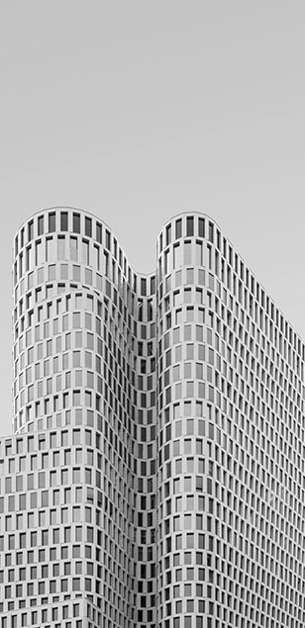
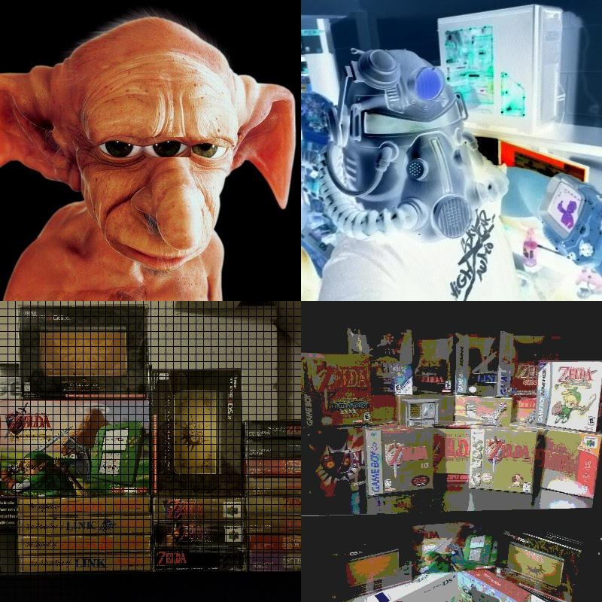
Title
After Program 1 is finished
We will take the output and use it for Program 2
This is the final output of Program 1 after the main function and all sub functions have been ran

Slide 6
Program 2
In program 2 I will be doing the following
Taking the output from Program 1 and make another canvas 3 times the width and height of the picture, and add the picture to all corners of the canvas
We will also have a turtle that will make a border around the entire canvas
Another turtle will also draw random lines over the canvas and photos in the corners, and it will use random colors
At the end of the turtle drawing the random lines the program will then add another copy of the photo to the very middle with no lines being drawn over it

Slide 7
Program 2 Layout
2
+
The layout for my second program includes
mainFn(path) that will have you choose the color of the canvas and to choose what picture you would like to use, it will also call the other sub functions and write the final canvas to the path you choose
subFn1 creates the turtle that will draw a blue border around the entire canvas
subFn2 will add the picture you choose to each corner of the canvas

Slide 8
Program 2 layout
subFn3 creates the turtle that will draw random lines all over the canvas and photos, it will also choose a random color to use as well
subFn4 will then take the photo you chose and add it to the very center of the canvas without and drawing over top of it

Slide 9
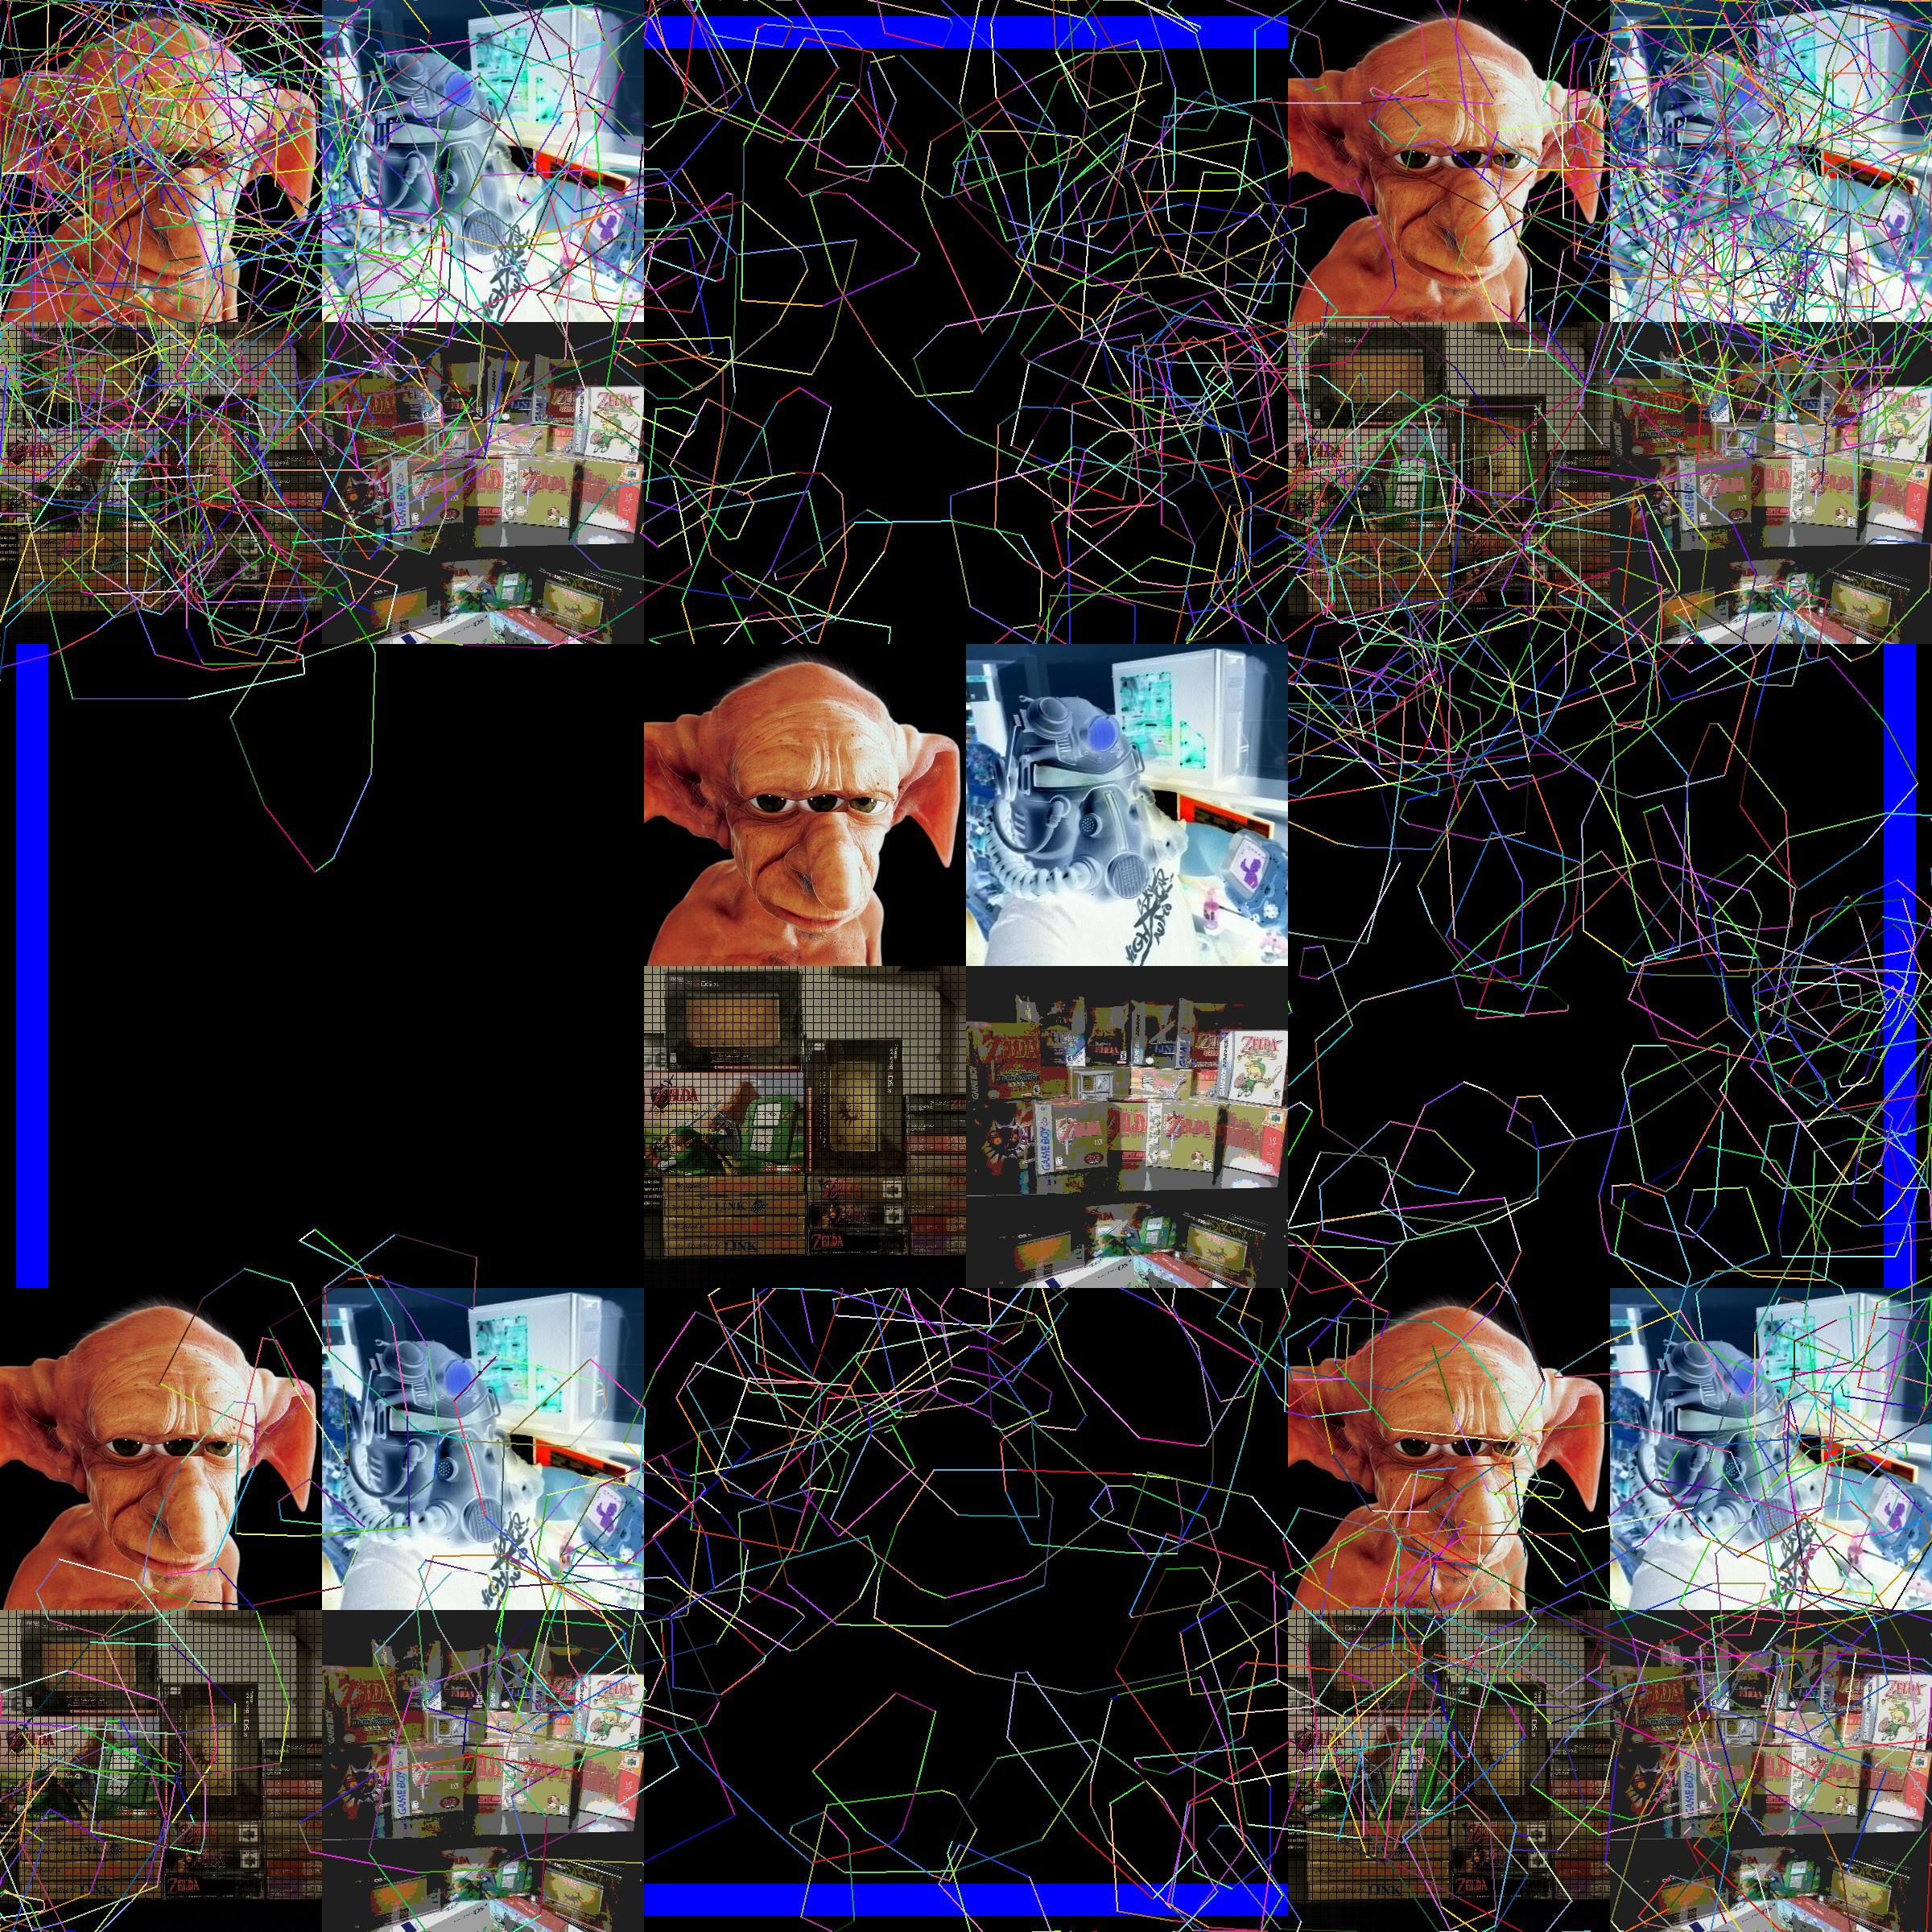
Title
Final output
This is the final output after both programs have been ran
Since one of the turtles makes random lines and random colors this output will change every time your run it

Slide 10
THANK YOU
2
+
2
+
That’s all I got

